Slide 1
Amazon Fine Food Review Analysis
Team 2
Abhishek Shivaprakash
Shengjie Shi
Xinlei Ma
Yue Shangguan
Viraj Karnik
Vivek Jayaraman

Slide 2
Introduction
1

Slide 3

Introduction
Why we Do:
Amazon is the one of the fastest growing companies in the USA with the focus of their online marketplace always being on capturing market share and being customer-obsessed. 55% of shoppers start their buying research on Amazon and 50% all shoppers say they rely primarily on Amazon for reviews. They provide a means to judge how influential their reviews are on other customers and how their reviews can be used to increase the output from other customers.
CRAS ULTRICIES LIGULA SED MAGNA DICTUM PORTA.
Who we are:
We are the Amazon food review analysis team and we are skilled at transferring pieces of data to strategic business implications.
What business problems can we solve:
For external stakeholder, how to improve customer satisfaction through reviews?
For internal stakeholder, how to help sales generate insights on product performance through reviews?

Slide 4
Descriptive Analysis
2

Slide 5
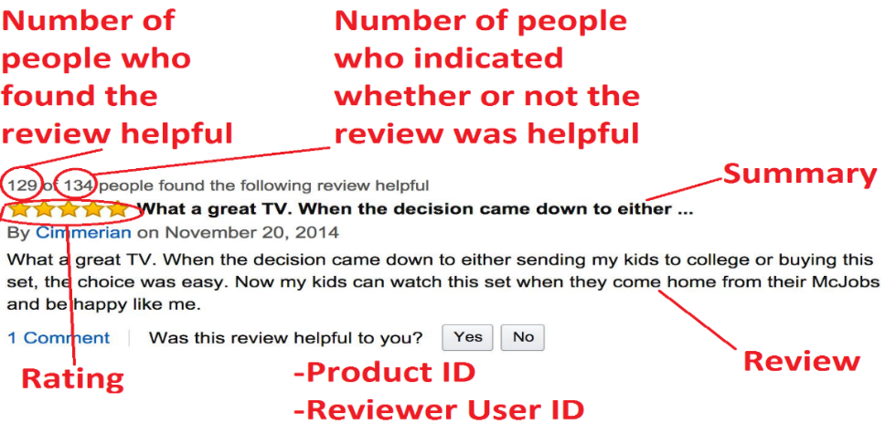
Data Summary
An explanation of our data
Distribution of ratings
We see that 5-star reviews constitute a large proportion (64%) of all reviews. The next most prevalent rating is 4-stars(14%), followed by 1-star (9%), 3-star (8%), and finally 2-star reviews (5%).
568455 text reviews
CRAS ULTRICIES LIGULA SED MAGNA DICTUM PORTA.
How do ratings affect helpfulness?
As the rating becomes more positive, the reviews become more. For 1-star reviews voted upon, 34% were voted helpful, while 27% were found not helpful. For 5-star reviews, 81% were found helpful and 7% not helpful.

Slide 6
Exploration Data Analysis
To learn what our data can tell us
Using User IDs, we can recognize repeat reviewers. Reviewers that have reviewed over 50 products account for over 5% of all reviews in the database. We call such reviewers frequent reviewers.
CRAS ULTRICIES LIGULA SED MAGNA DICTUM PORTA.
How does frequency affect distribution?
The distribution of ratings among frequent reviewers is similar to that of all reviews. However, we can see that frequent reviewers give less 5-star reviews and less 1-star reviews. Frequent reviewers are more likely to have their review voted on and when voted on, more likely to be voted helpful, and less likely to be unhelpful.
Distribution of helpfulness
Among all reviews, almost half (48%) are not voted on at all. Helpful reviews had more than 75% of voters who find the review helpful while unhelpful reviews had less than 25% of voters who found the review helpful

Slide 7
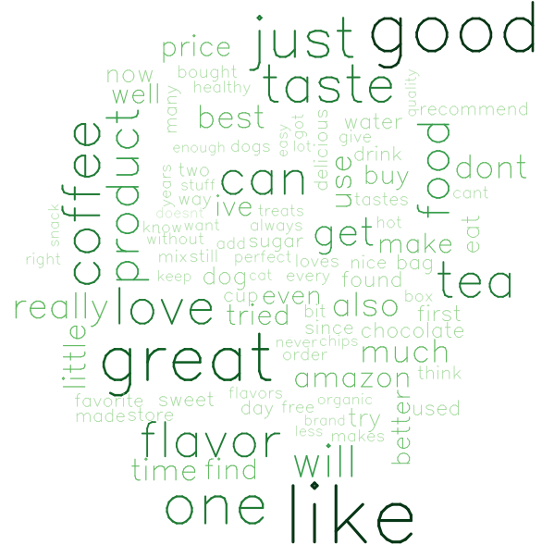
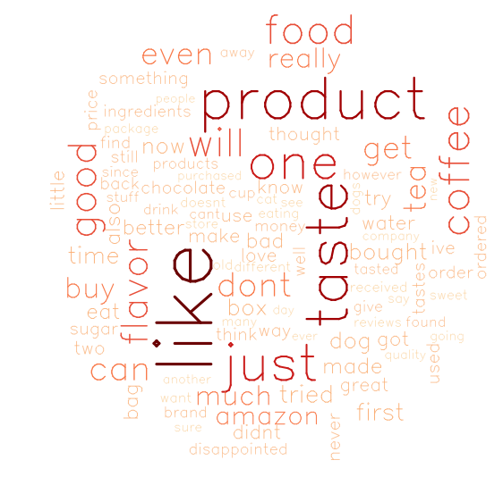
Exploration Data Analysis
To learn what our data can tell us
CRAS ULTRICIES LIGULA SED MAGNA DICTUM PORTA.
Common words in positive reviews
Common words in negative reviews
Popular words in reviews
A look at the post popular words in positive (4-5 stars) and negative (1-2 stars) reviews shows that both positive and negative reviews share many popular words, such as "like", "taste", "flavor", "one", "just", and "product." These words are too general to be of much help to consumers.

Slide 8
Problem Exploration
What problem can we solve after data visualizations
Through exploration data analysis, we found that:
Although the number of reviews with 5-star is the highest, nearly half of consumers still think the reviews are unhelpfulness.
In the 5-star product reviews, the number of frequency reviewers is the highest, among which the possibility of paid reviewers is not excluded.
CRAS ULTRICIES LIGULA SED MAGNA DICTUM PORTA.
To better help customers identify helpful 5-star reviews and improve users reliability, we will use text mining and helpfulness as a variable to explore more specific and authentic reviews as well as product patterns.

Slide 9
Methodology
3

Slide 10
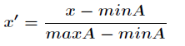
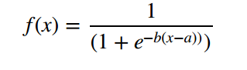
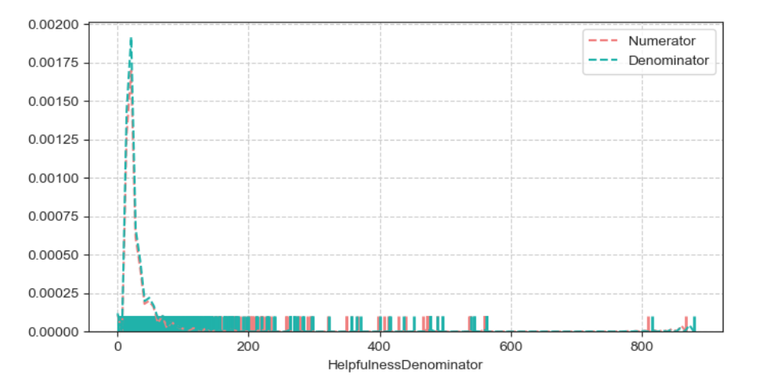
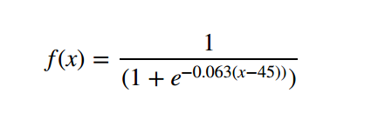
Methodology—Helpfulness Percentage Adjustment
Helpfulness Percentage Adjustment is the process of eliminating the effect of skewedness
To determine if a given review text is helpful or not, we need a way to map the existing data to binary classification. The way is that calculate ratio of the people who found the review helpful over the amount of people who rated the review as helpful or unhelpful. If this ratio exceeds a certain threshold value, we can label the training data as 'helpful' = 1, or 'non-helpful' = 0. For this analysis, the threshold is arbitrarily set to 0.5 .
Helpfulness Percentage= helpful _ numerator / helpful _ denominator
☒
☑
Normalized
Sigmoid

Slide 11





Methodology—Text Mining
Text mining is the process of exploring and analyzing large amounts of unstructured text data
Data cleaning
Natural language processing
Sentiment & Topic Detection
Visualization & LDA tool
CRAS ULTRICIES LIGULA SED MAGNA DICTUM PORTA.
Preprocess the text data
Remove stop words
Parts of Speech tagging (identify verb, noun, etc.)
Tokenization (extract words, removing punctuations, numbers)
Sentiment analysis( Positive & Negative)
Topic modeling: Google's Trained word2vec on Google News
Word frequencies & word clouds
Sentiment scores
Topic visualization & profiling

Slide 12
Data Processing
4

Slide 13
Text Feature Engineering
Cleaning and pre-processing textual data
Step 1: Stemming - Stemming means to take off the suffixes of the stemmed word. Therefore words such as "run" and "running" would both be represented as "run".
Step 2: Tokenizing- Splits sentences up into single words.
Step 3: Remove Stop Words- This moves words such as “the” “a” and “it” as shown in the English stop words corpus. Admittingly, sentences without these words are hard to understand, and ideally they should be kept, but it is again a trade-off.
Step 4: ngrams- Makes groups of words that are 'n' long. Having more than that is computationally expensive.
"the sun is shining" = "the sun shines“. It will reduce the total amount of features that we will generate.
The 2-grams for the sentence "The shaggy dog" are [The, shaggy], [The, dog] and [shaggy, dog].

Slide 14
Modeling
5

Slide 15
Sentiment Analysis
Polarity results based on reviews’ attitude for 5 rating
Rating sentiment analysis shows that the higher the rate, the more positive words in reviews.

Slide 16
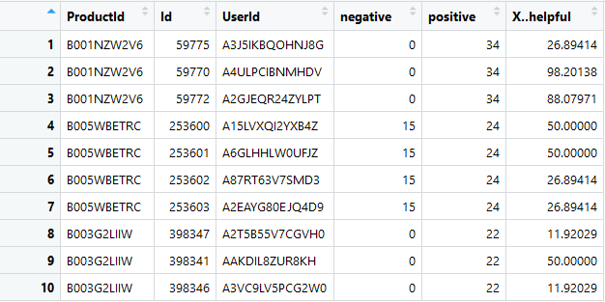
Sentiment Analysis
5-star Products Reviews with the higher helpfulness
CRAS ULTRICIES LIGULA SED MAGNA DICTUM PORTA.
http://ptrckprry.com/course/ssd/data/positive-words.txt
We joint more than 50% of helpfulness into the sentiment analysis.

Slide 17
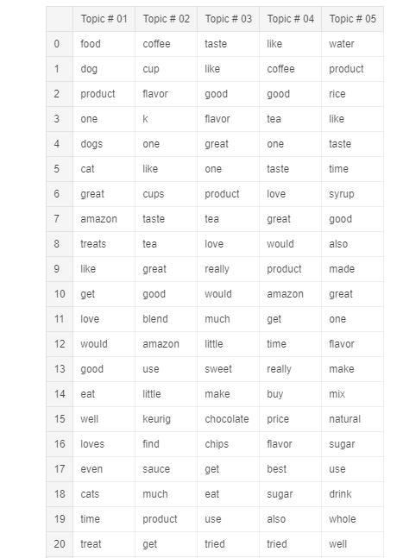
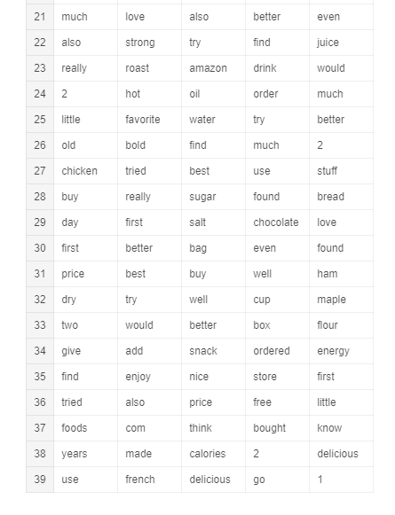
Topic Modeling
Top 5 topic modeling with LDA
CRAS ULTRICIES LIGULA SED MAGNA DICTUM PORTA.

Slide 18
Topic Modeling
Highest probability words associate with feature words
Taste features #shows topics with highest probability words
association$artificial
high double expectations flavoring gets hadnt
0.55 0.53 0.53 0.53 0.53 0.53
kills pack reported sweeteners sweetner migraines
0.53 0.53 0.53 0.44 0.41 0.41
diet heat household plenty soda allergy
0.38 0.37 0.37 0.37 0.37 0.37
arrives attack cause changed eligible flag
0.37 0.37 0.37 0.37 0.37 0.37
items older phenylalanine severe state stated
0.37 0.37 0.37 0.37 0.37 0.37
stating yellow really gotten worse sweetener
0.37 0.37 0.35 0.34 0.34 0.32
association$dead
Heard thinking old year instead package say
0.67 0.67 0.65 0.61 0.53 0.50 0.48
little also awe closely cloverdales deceased deceived
0.48 0.45 0.45 0.45 0.45 0.45 0.45
deception flawless fun hold issue john leave
0.45 0.45 0.45 0.45 0.45 0.45 0.45
listening message neighbors ordering page rocks simple
0.45 0.45 0.45 0.45 0.45 0.45 0.45
son suffice tesh young accidentally across actually
0.45 0.45 0.45 0.45 0.45 0.45 0.45
ages anything arm around awaiting barely bathroom
0.45 0.45 0.45 0.45 0.45 0.45 0.45

Slide 19
Model Visualization
5-stars Products Reviews with the higher helpfulness
word freq
machine 102
coffee 98
espresso 83
vienna 41
years 37
saeco 34
use 34
make 31
cup 30
water 29
Text: I have had this machine for a few weeks now and love it after years of the hassle of steam machines. It is so easy to use and clean that I look forward to my daily cups of espresso instead of looking at it as a chore. I also save counter space as I do not have to share it with a grinder anymore. It is also very nice to have a hot cup finally every other machine just never seemed to get hot enough.
CRAS ULTRICIES LIGULA SED MAGNA DICTUM PORTA.
Coffee Machine
The word cloud can clearly demonstrate the product pattern from reviews. Also in word frequency, we can know the a few of specific features of this product. From review text, we learn more detailed experience after Amazon service. Our model provides an elaborate and precise review result.

Slide 20
Model Visualization
5-star Products Reviews based on the higher helpfulness
word freq
potatoes 34
great 24
mashed 23
instant 11
like 11
best 10
costco 9
real 8
taste 8
price 7
product 6
creamy 6
CRAS ULTRICIES LIGULA SED MAGNA DICTUM PORTA.
Text: These mashed potatoes are incredible quick easy and taste like homemade. The only issue is the cost .This same box was about half the price at Costco. However its apparently a seasonal item for Costco and they wont be carrying them again until fall other than the price. The service from amazon was great.
Mashed Potatoes
The word cloud can clearly demonstrate the product is mainly about mashed potatoes. Also in word frequency, we can know the a few of customer tastes about this product. From review text, we learn more details about price. Our model provides a obvious users taste preference.

Slide 21
Model Visualization
1&2-star Products Reviews with the higher helpfulness
word freq
cider 74
apple 51
taste 49
product 37
cup 34
like 33
Sugar 26
hot 24
flavor 22
artificial 19
caramel 19
Sweet 18
horrible 18
Text: i was really looking forward to having some good apple cider out of my keurig machine the cider has a wierd taste to it and a very bad aftertaste after my wife and i both tried a cup we ended up throwing the rest of it out it has artificial sweeteners not noted on the product page that where the weird aftertaste reviews come from stick to the green mountain version which is wonderful
Apple Cider
The word cloud can clearly demonstrate the product pattern from reviews. Also in word frequency, we can know the a few of specific features of this product. From review text, we learn the reason of bad experience is artificial taste.

Slide 22
Model Visualization
Top 5 Products Reviews with the higher helpfulness
word freq
rabbit 50
amazon 15
easter 14
Box 13
fresh 12 whole 11
dead 10
will 9
pet 7
Bunny 6
began 6
hours 5
Texts: shirley was a healthy seven year old content with playing with her dolls and stuffed animals but then the rabbit arrived and well i must say it has changed her but this rabbit is pure evil and is somehow controlling my daughter today i went into her room to tell her dinner was ready and found her chanting in some foreign tongue in front of the rabbit which she had place on a table and surrounded with candles i am at a complete loss what can i possible do to save shirleys soul i urge people not to purchase these rabbits and if you do be it on your own
Rabbits
The word cloud can clearly demonstrate the product pattern from reviews. Also in word frequency, the flavor of product can be described. In texts review, this product seems a weird toll for children and parents.

Slide 23
Implications
6

Slide 24
Business Implications
Business benefits based on our model
Keep constant tabs on what people like and do not like about the food product. Also zero in on which segments like which things, and how to appeal to those audiences. E.g., top 5 helpful reviews shows the products patterns and users preference.
Empower Amazon product development team with incredible insight into specifics of product performance. E.g., the price comparison with Costco and take action immediately.
For a single product, it can provide insight on what feature is important and for multiple products, it can be used for comparison. This data can be sent to the suppliers and developers.
Customers Satisfaction
Sales Team Benefits
Product improvement

Slide 25
Business Implications
Business benefits based on our model
The reviews by paid reviewers can be eliminated or tagged so that the customers get an accurate representation of the product.
Patterns of false negative reviews from ‘Negative Feedback services’ can be eliminated to prevent unjust disqualifications of products.
This data analysis can be used to develop a recommendation system for the specific users based on their tastes and requirements
Customers Benefits
Sellers Benefits
Recommendation System

Slide 26
Future Improvements
We can do better
DATASET UPDATE
CHANGE IN OPINIONS
The data is collected before 2013. We have to use real time data that can be collected through web scraping.
Future iterations can be run to see the change in opinions with improvement in products.
MORE DESCRIPTIONS
MODEL IMPROVEMENT
DATA IMPROVEMENT
More product type descriptions are needed to improve the performance.
In the future a deep machine learning model can be used to predict the product rating based only on the review.
There are examples of mischaracterization in the data where the review for other categories are in this data.

Slide 27
THANK YOU

